Slide 1

User-Interface Design WUIV302
Lynette Barnard

Slide 2

Agenda
Admin
Overview: What is Interaction Design?

Slide 3

Overview
Welcome to WUIV302
Sessions
Thu 07:45 – 08:55, Lab 4
Thu 13:05 – 14:15, Lab 4
Official class list – check detail & sign (ONE copy)
Not registered? Add to the bottom of the list

Slide 4
Some more admin
House rules
Respect (punctual, participate, share, listen)
Play by the rules
Submissions – shared responsibility
Submission & feedback
Willing to help those that help themselves
Anything from your side?

Slide 5
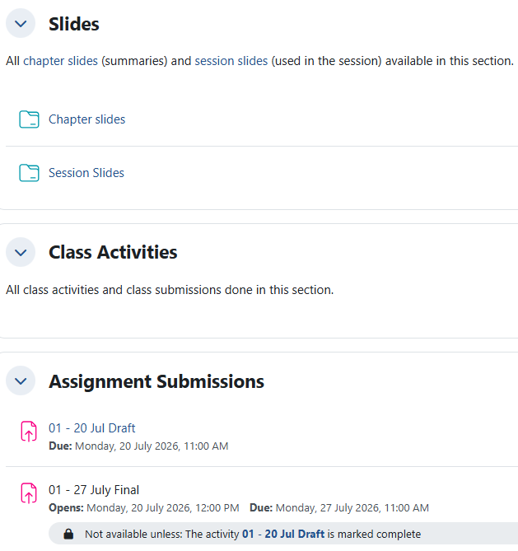
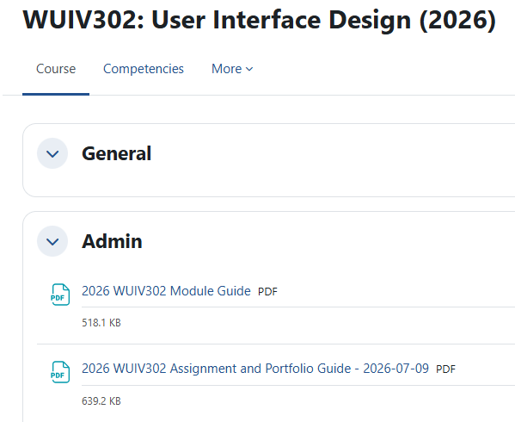
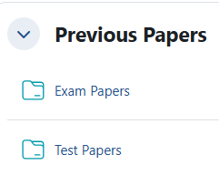
Module material on Funda

Slide 6

Module material on Funda
Module Guide
Continuous assessment
Multiple assessments / various improvement opportunities
No exam
No re-assessment
No LO
Assignment & Portfolio Guide

Slide 7

Going digital
Digital / electronic / interactive product use
Image by wayhomestudio on Magnific

Slide 8
Quote
Key issues in interaction design (ID)
Need to develop usable interactive products
Two key questions
1. How do you optimise a person’s interaction with something (system / environment / product) so that it supports the person’s activities in an effective, useful, usable, pleasurable way?
2. How safe and private is the data being collected?

Slide 9
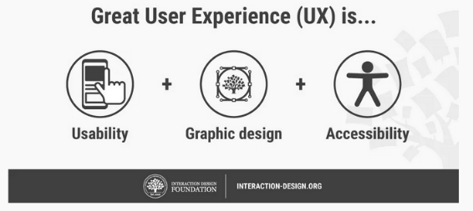
What do we design?
Need to develop usable interactive products
Easy to learn, effective to use, enjoyable, …
Create experiences enhancing / supporting the way people work, communicate, interact
E.g., user interfaces, web sites, check-out points, consumer item interfaces, …
Before deciding on what, consider who, how, when and where
Bottom line: understand the people that will be using your design
Their abilities, what they are good at, what they struggle with

Slide 10
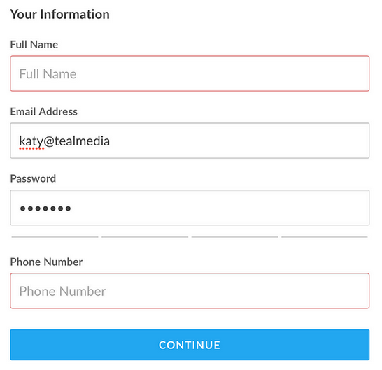
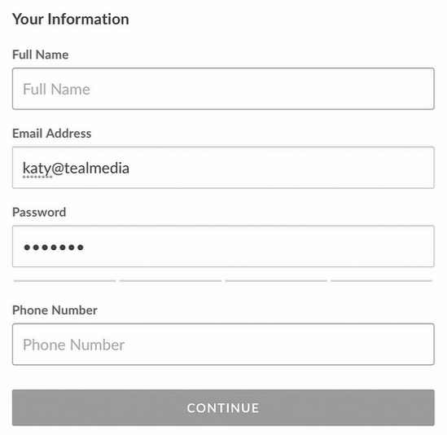

Slide 11
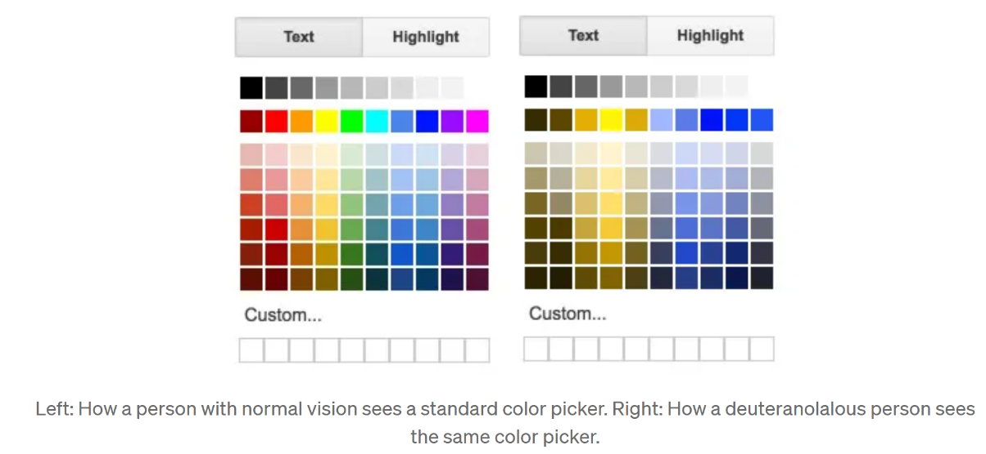
https://blog.prototypr.io/going-colorblind-an-experiment-in-empathy-and-accessibility-98b7003737ca
Simulator: https://www.color-blindness.com/coblis-color-blindness-simulator/

Slide 12
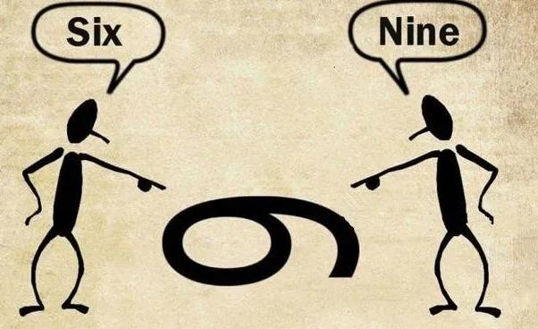
Perceptions
Perception defined:
a belief or opinion, often held by many people and based on how things seem
Cambridge Dictionary

Slide 13



Slide 14
Testing the Brain and shades of grey

Slide 15
User Experience (UX) and Usability
Important to be clear about primary objective of developing interactive product
Objectives often classified into usability goals and UX
Usability goals traditionally about meeting usability criteria
UX concerned with clarifying nature of experience of the user
Thus UX - how a user (person) experiences a product in the real world
Good vs Bad design examples
See Bad Design vs. Good Design: 5 Examples We Can Learn From | IxDF

Slide 16
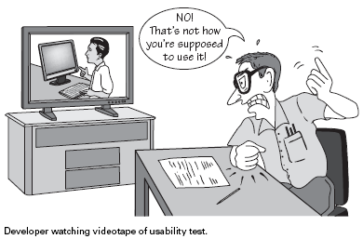
Seven usability goals
Effectiveness – how good product is at doing what it is supposed to do
Efficiency – way in which product supports user carrying out tasks
Safety – protect user from dangerous conditions and undesirable situations
Utility – extent to which product provides right kind of functionality so user can do what he needs to do
Learnability – how easy is the system to learn to use
Memorability – how easy it is to remember how to, once you’ve learned how to use the product
Satisfaction – how enjoyable it is to use

Slide 17
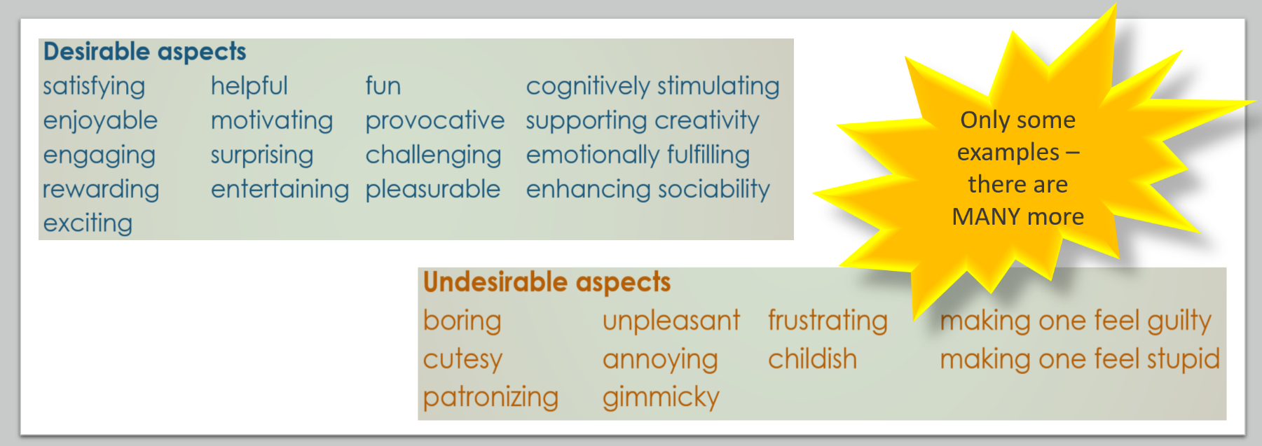
UX
Consider emotions and felt experiences
Often subjective qualities – related to specific user / person
How product is experienced from user / person perspective

Slide 18
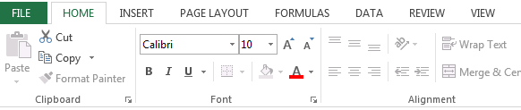
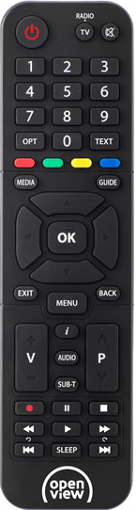

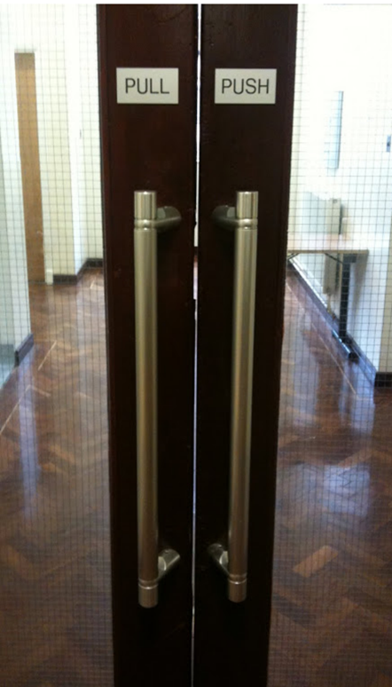
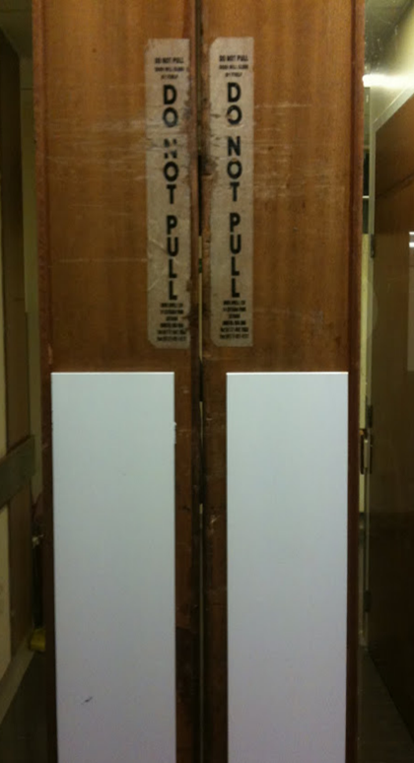

Design principles
Constraints
3.
Visibility
1.
Affordance
5.
Feedback
2.
4.
Consistency

Slide 19
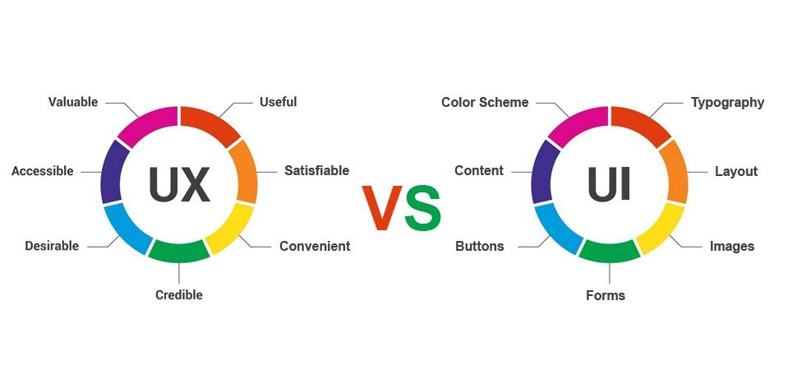

Slide 20

Should have booked slot on Funda
Ensure you understand content in both guides
First assignment draft due 20 July
Jeff Stapleton on pexels.com

